Slide 1
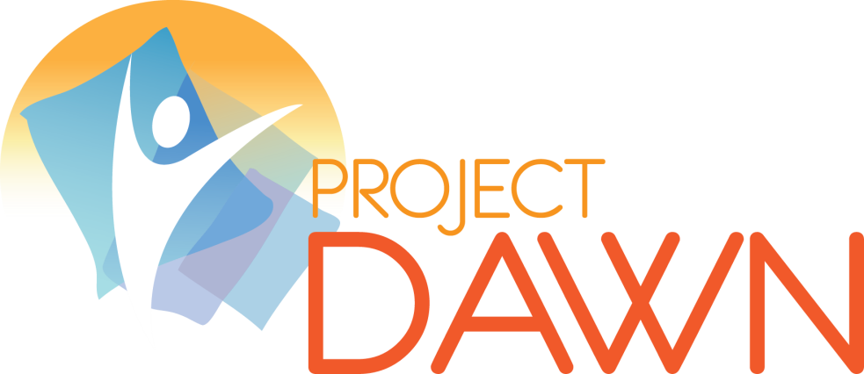
Lorain County

Slide 2
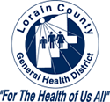



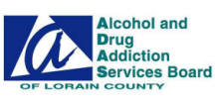

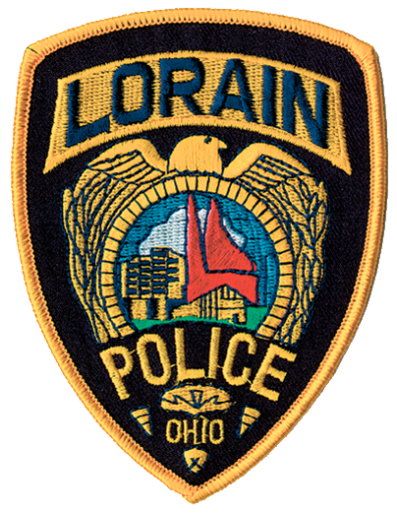
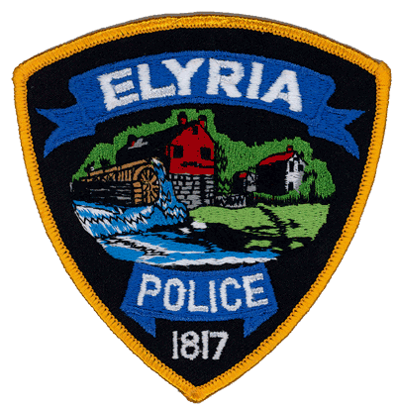
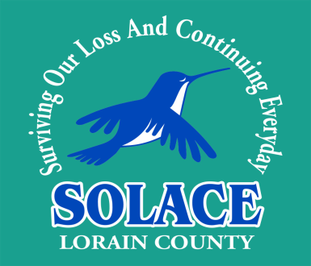
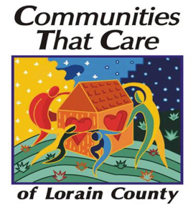

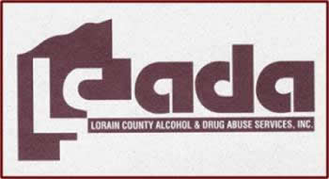

Dr Stephen Evans- Lorain County Coroner’s Office
Alcohol and Drug Addiction Services
Lorain Police Department
Lorain County Sheriff’s Office
Elyria Police Department
Lorain County Prosecutors Office
Lorain County Drug Abuse Services
Lorain County General Health District
Lorain City Health Department
Elyria Health Department
Mercy Hospital and Elyria Memorial Hospital
SOLACE
Lorain City Schools TV 20

Slide 3
Deaths Avoided With Naloxone
What is Naloxone?
Naloxone commonly known as Narcan is a medication that can reverse and overdose caused by an opioid drug. When administered during an overdose, Naloxone blocks the effects of opioids on the brain and restores breathing within two to eight minutes. It has been safely used by emergency medical professionals for over forty years and has only one function: to reverse the effects of opioids on the brain and respiratory system to prevent death.

Slide 4
Liability Concerns……………..
No Liability if acting in good faith for first responders

Slide 5
One in six people have used Opiods inappropriately
One in thirty seven are addicted to Opiods
Drug overdoses have become the leading cause of accidental death in Lorain County, the State of Ohio and The United States
The number of overdose deaths in Lorain County tripled between 2011 and 2012

Slide 6
Overdose prevention…
Overdose affects some individuals directly others more indirectly and the society at large
Lives can be saved
Conversations about overdose prevention and reversal can provide another way for providers and clients to connect and develop rapport
OVERDOSE DEATHS CAN BE PREVENTED BY THE LAY PERSON
(First responders, family, friends and YOU!!!!)

Slide 7
The fact that overdose prevention programs exist send the message that people’s lives are worth saving, that their lives are important, that the public health systems and community members do want programs like this around
Overdose responders are proud of their involvement in overdose prevention

Slide 8
Myths about overdose and reversal
It is a waste of time to give opioid users Narcan, since they are not capable of recognizing and managing an OD
The person who receives Narcan will react violently when the medication is administered and his/her OD is reversed
The fact that drug users can have access to Narcan will postpone their entry into drug treatment, and it will also encourage riskier drug use

Slide 9
What are opioids/opiates?
Opioids are sedative narcotics
They are used in medicine mainly to relieve pain
Opioids repress the urge to breathe- when someone is having an opioid overdose, they stop breathing and could die

Slide 10
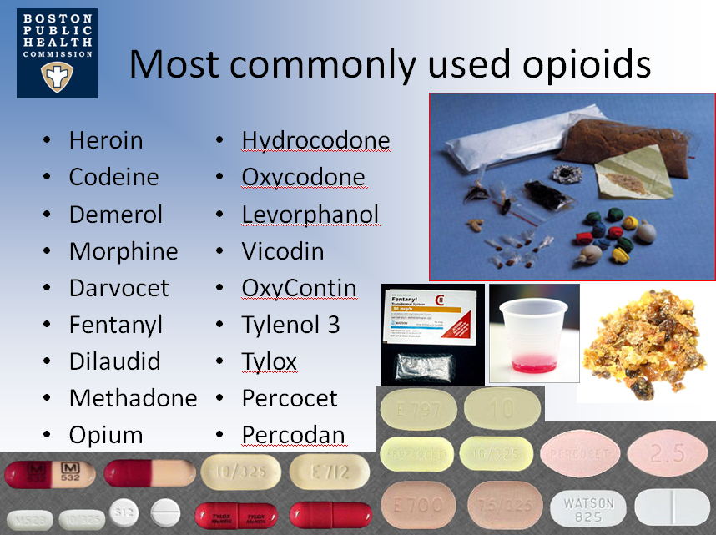

Slide 11
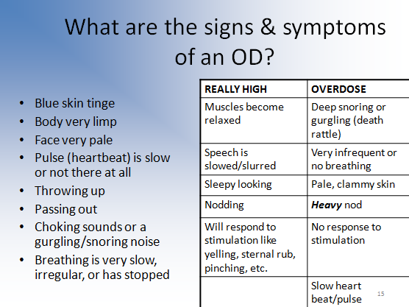
If person is awake and coherent wait for rescue squad

Slide 12
What puts people at risks for overdoses?
Changes in tolerance- People who have not used and coming back to their normal dose (Leaving rehab, or an extended period of being clean)
Mixing drugs- benzos, alcohol & cocaine especially
Physical health
Previous experience of non-fatal overdose
Variation in strength and content of ‘street’ drugs

Slide 13
Reporting for first responders
In addition to any other reporting as per agency policy a simple one page form will be used
This will be submitted and is important to keep track of Narcan administered and saves for first responders

Slide 15
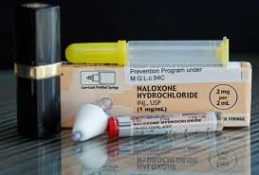
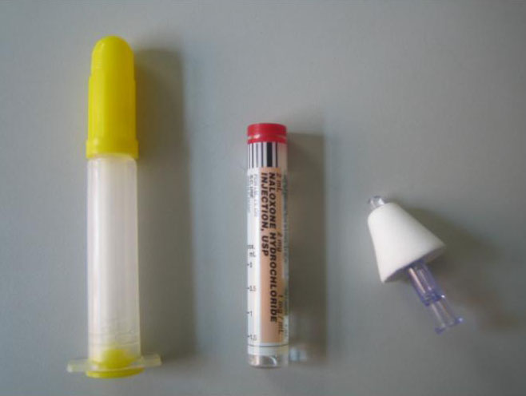

Slide 16
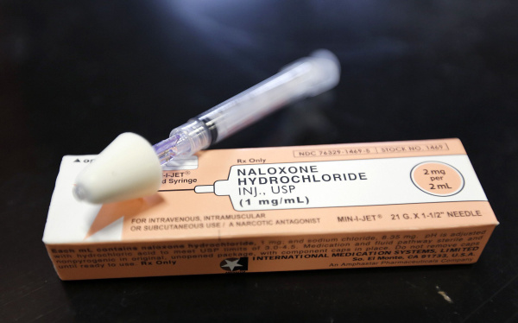

Slide 17
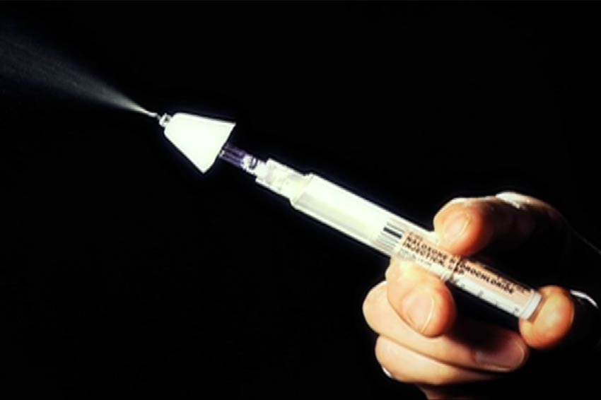
Atomizer

Slide 18
Additional Points:
If an overdose occurs CALL 911
Administer Narcan
Place victim in recovery position
Consider rescue breathing

Slide 19
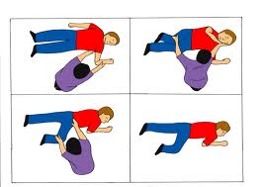
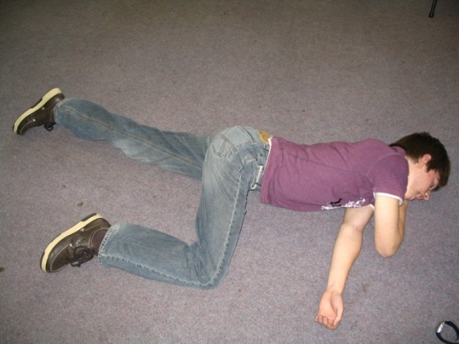
Placing a person on their side or recovery position can assist in keeping their airway clear

Slide 20
See video for instructions….

Slide 21
Questions???????????????????????????

